Slide 1
home automation light system
Hafiz rehmatullah Fa21-bce-061
Muhammad hassan fa21-bce-051
Syed muhammad hashir fa21-bce-032

Slide 2
Outline
Introduction
Literature Review
Methodology
Flow chart
Software model
Results
Teamwork / Tasks Division
Societal Impact
Environmental Impact
Conclusion

Slide 3
Introduction:
In this project we design a room light management system for the power consumption and power saving using PIC18F452 microcontroller and IR sensors to detect the movement of person entering or leaving the room and with respect to that counter will increment or decrement and display the result in the LCD and LED will be turned ON.

Slide 4
Lighting control systems provide the desired amount of light where and when it is needed. They are used to maximize energy savings, satisfy building codes, provide safety & security, or comply with green building and energy conservation programs.
Power consumption is a major issue in our society and to save that power loss we must came up with an idea of how we are going to save that. This project main goal is to count the person entering and leaving the room through IR sensors and increment and decrement the system so that lights will be ON/OFF respectively.

Slide 5
Literature Review
The lighting energy use is the largest contributor to the commercial buildings’ energy consumption, the average of 38% (DoE, U. S., 2011)[2]. “In the year of 2010, showcasing 44 percent rise in comparison with the transportation industry in addition to 36 percent rise as compared with the manufacturing industry (DoE, U. S., 2011)”. This system is designed to control the lighting system of the room by turning on the lights automatically whenever there are one or more persons in the room. The aim is to turn on the light when someone enters the room and turn off the light when the last person leaves the room, the project has to internally count the number of visitors entering and leaving the room.

Slide 6

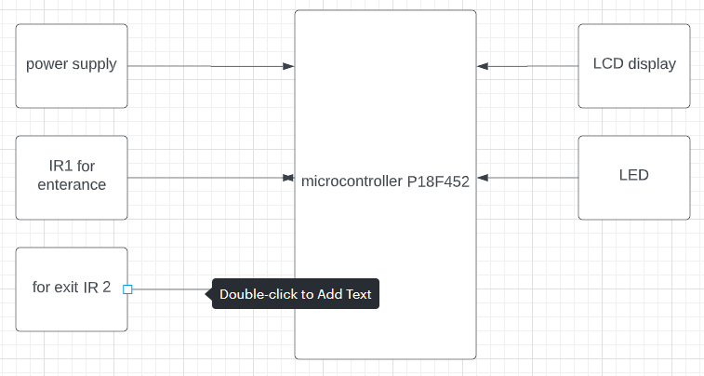
Methodology
Block Diagram

Slide 7
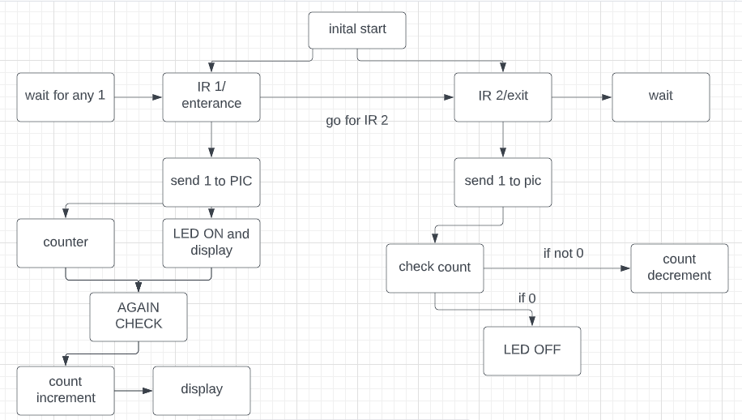
Flow chart

Slide 8
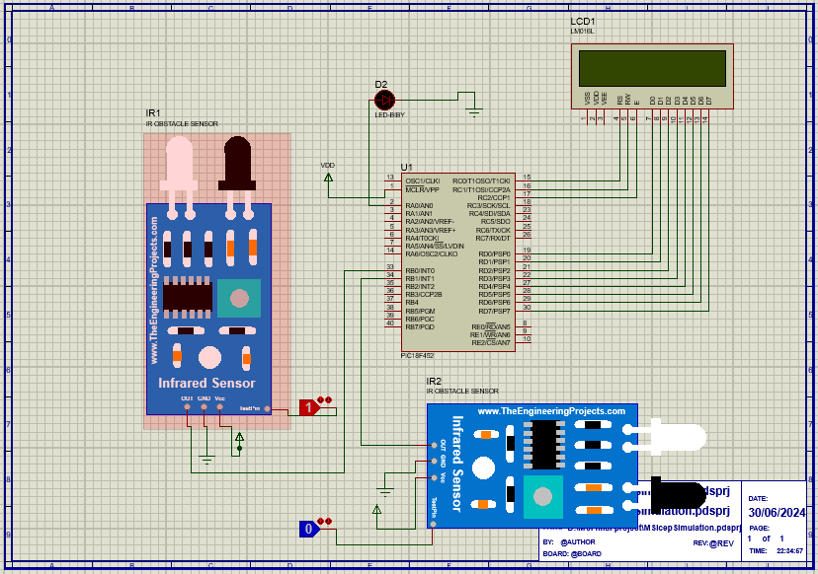
Software model:

Slide 9
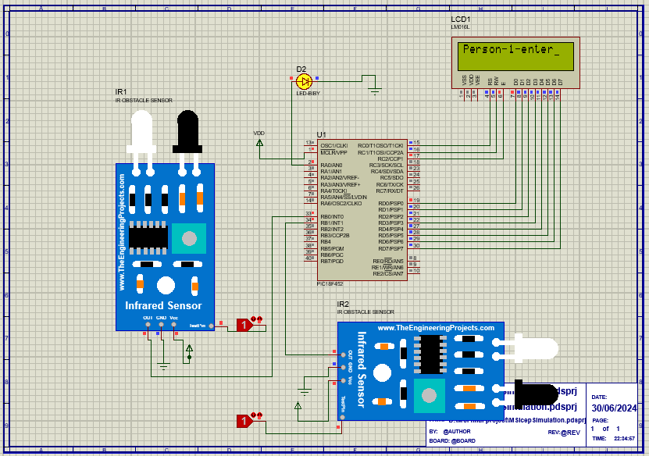
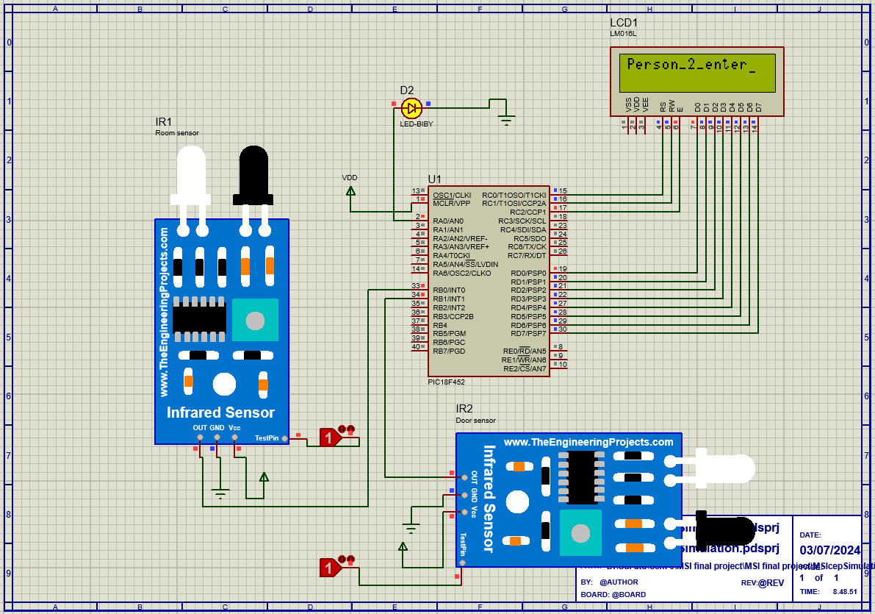
Results:
When a person enter

Slide 10
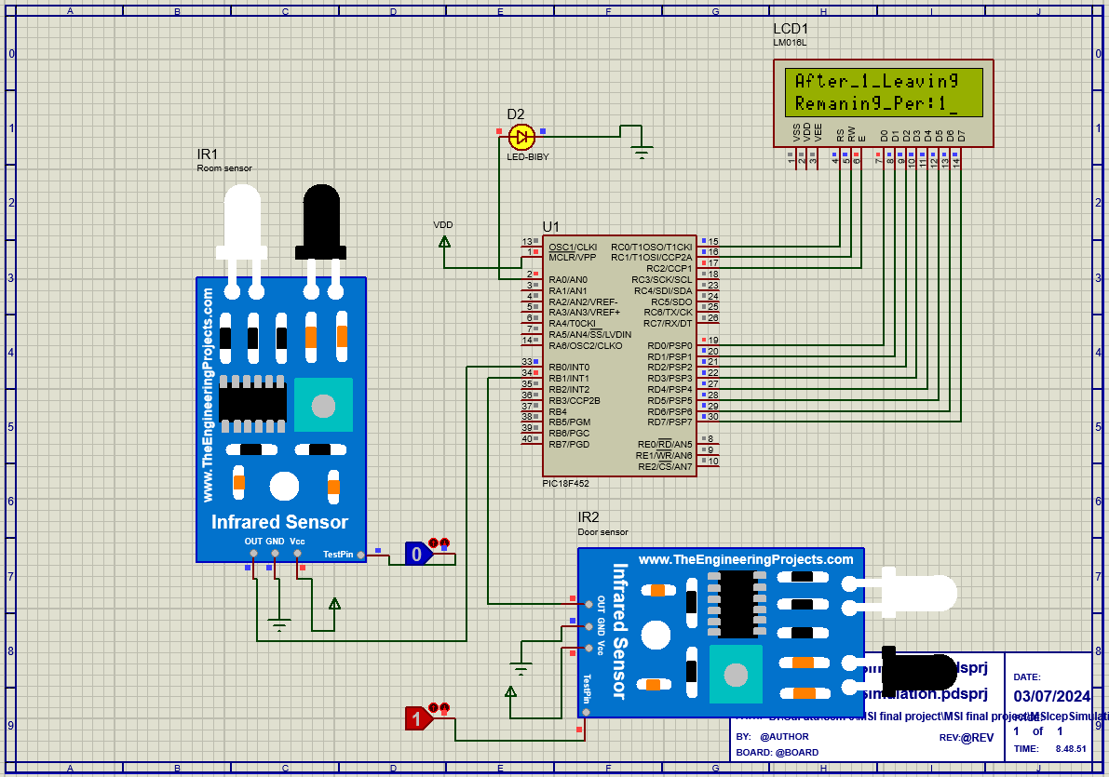
Results: After-1-Leaving C(person) are

Slide 11
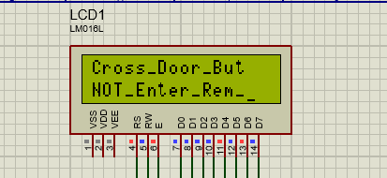
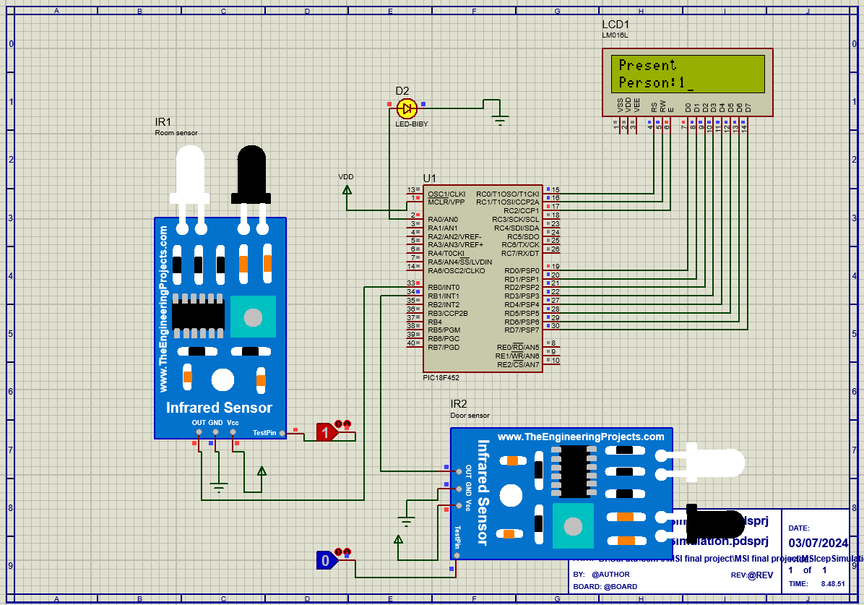
Results:
Person cross door but not present in room

Slide 12
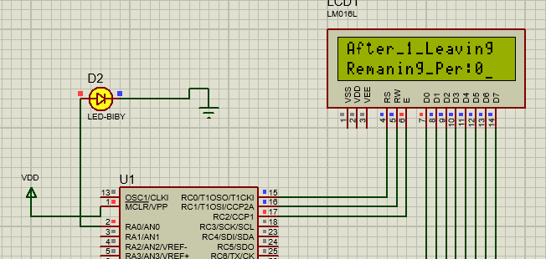
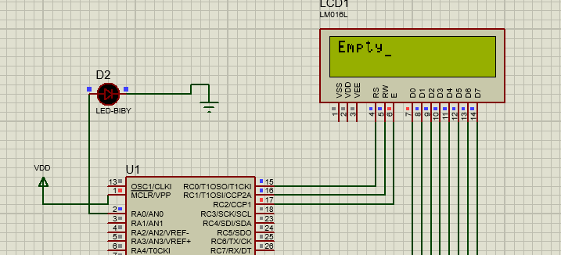
Results:
When all person leave the room

Slide 13
Teamwork/Tasks Division
The workload was distributed among the teammate:
Hassan and Hashir did the Code & proteus Simulink diagram.
Hafiz Rehmatullah prepared report.
Hafiz Rehmatullah prepared presentation.
And we all work together on hardware.
The students effectively completed and presented the CEP as a team
YES.

Slide 14


Societal Impact
The use of automated lighting control systems allows to reduce lighting costs and to achieve significant energy savings. But safety and liability are a huge concern for the lighting system project. The system is very beneficial for consumers who are looking for home automation. Increased energy efficiency. The golden rule for saving electricity: The less time your lights are on, the lower your electricity bill will be. An efficient lighting control system should provide the correct amount of electric light for an appropriate work environment while saving energy. Such automation is very useful in certain areas like energy consumption, reducing human efforts, improving standard of living etc.

Slide 15
Environmental Impact
Lighting negatively affects the environment as it disrupts the natural light cycles that species are cued into. These include changes in time partitioning such as singing, activity and foraging in animals, or altering individual health. The right light gives a hotel room a bright and friendly atmosphere. The wrong light can ruin a nicely decorated room. Lighting control solutions provide a comfortable and productive visual environment, enhancing the comfort levels of a space leads to increases in productivity.

Slide 16
Conclusion
In this project we design a room light management system for the power consumption and power saving using PIC18F452 microcontroller and IR sensors to detect the movement of person entering or leaving the room and with respect to that counter will increment or decrement and display the result in the LCD and LED will be turned ON. When a single person enters LED will turn ON and will remain ON for rest of 4 persons and will turn OFF when all the persons exit the room.

Slide 17
Thank You!

